Slide 1
Digital Thinking and Innovation
Innovation through Artificial Intelligence

Slide 2
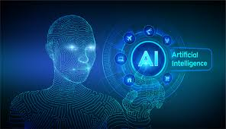
Introduction
This topic discusses the concept of Artificial Intelligence and the AI technologies taking place in our everyday lives.

Slide 3
Learning Outcomes for the Lecture
At the end of this lecture you will be able to:
Understand the term Artificial Intelligence
Explain the concept of expert systems
Understand the importance of machine learning
Explain the frontiers of Artificial Intelligence
Discuss the impacts of Artificial Intelligence

Slide 4
Content
Artificial Intelligence
Expert Systems
Machine Learning
Neural Network
AI Frontiers
Robotics
Computer Vision
Voice Recognition
Natural Language Processing
Impacts of AI on Human Labor

Slide 5
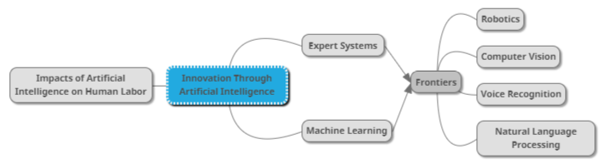
Mind Map

Slide 6
Learning Outcomes for the Lecture
At the end of this lecture you will be able to:
Understand the term Artificial Intelligence
Explain the concept of expert systems
Understand the importance of machine learning
Explain the frontiers of Artificial Intelligence
Discuss the impacts of Artificial Intelligence

Slide 7
Artificial Intelligence
Artificial Intelligence (AI): The concept of creating computer programs or machines capable of behavior we would regard as intelligent if exhibited by humans
An important truth: this new technology will impact a great many things that we hold dear, from our livelihoods to our sense of self.
What AI movie that you have watched?

Slide 8

Group Discussion
Watch and discuss the content of the video:
https://www.youtube.com/watch?v=ad79nYk2keg

Slide 9
Learning Outcomes for the Lecture
At the end of this lecture you will be able to:
Understand the term Artificial Intelligence
Explain the concept of expert systems
Understand the importance of machine learning
Explain the frontiers of Artificial Intelligence
Discuss the impacts of Artificial Intelligence

Slide 10
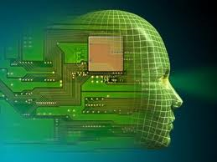
Expert System
System that employs human knowledge captured in a computer to solve problems that ordinarily requires human expertise.
ES imitates an Expert’s reasoning processes to solve specific problems.
Key word – problem solving through
Thinking + Perception + Action

Slide 11
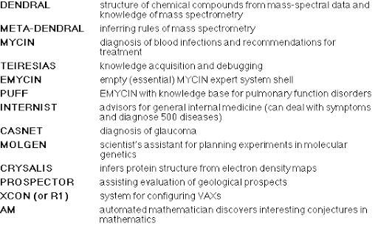
Medical Expert System

Slide 12
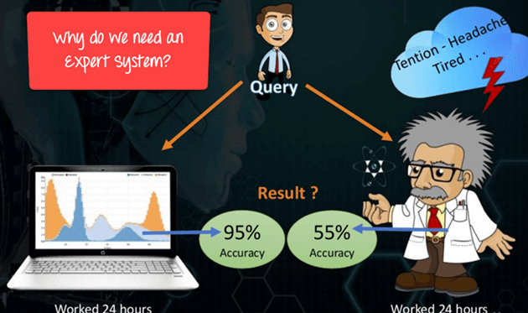
Why Expert System

Slide 13
Why Use Expert Systems
To preserve knowledge
Helps if expertise is scarce, expensive and unavailable
Helps if under time and pressure constraints
eg Medical emergencies
To train new employees
eg CBT (Cognitive behavioral therapy (CBT))
To improve worker productivity
eg Ask the Expert

Slide 14
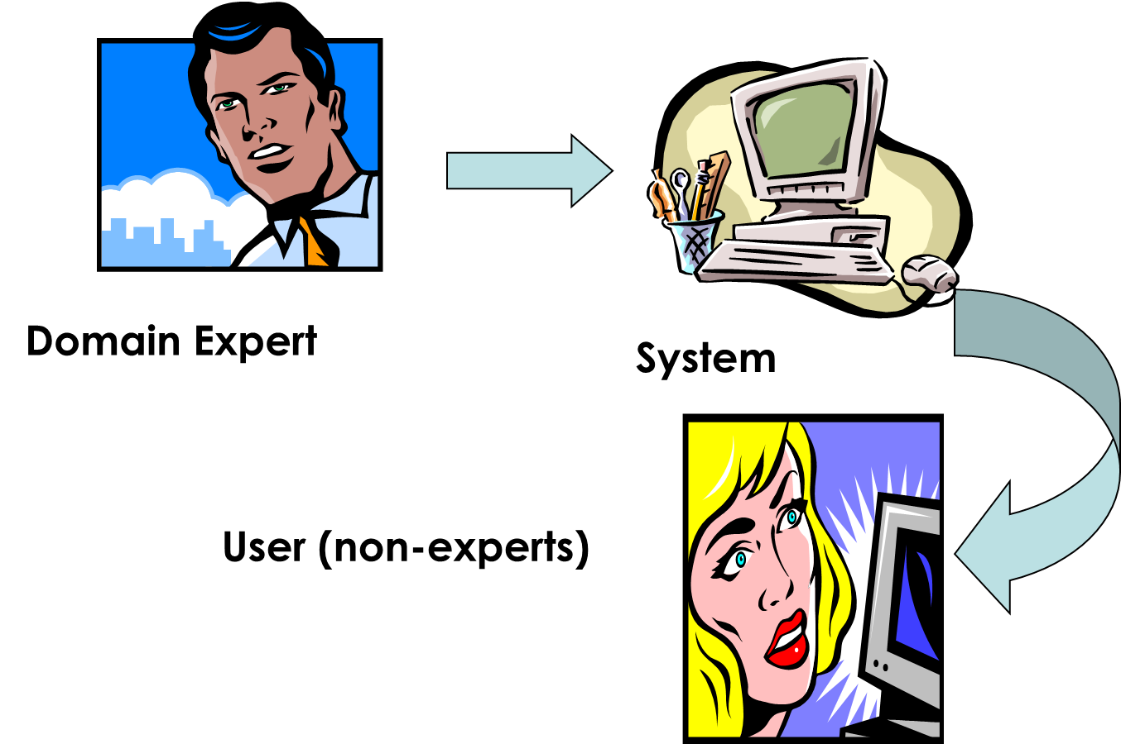
Concept of Expert System
Experts
Transferring Expertise
Rules and Inferencing
IF Face is pale AND Pulse is accelerated
THEN Patient is in shock
THEREFORE
Help patient to lie down
Raise and Support Legs
Loosen tight clothing
Explanation Capability

Slide 15
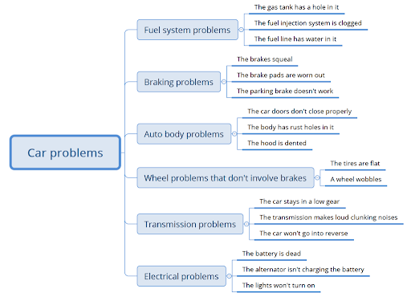
Another examples…

Slide 16
Group Discussion…
Watch and discuss the content of the video
https://www.youtube.com/watch?v=R49U8pHnb4g

Slide 17
Learning Outcomes for the Lecture
At the end of this lecture you will be able to:
Understand the term Artificial Intelligence
Explain the concept of expert systems
Understand the importance of machine learning
Explain the frontiers of Artificial Intelligence
Discuss the impacts of Artificial Intelligence

Slide 18
Machine Learning
Machine learning is a method of data analysis that automates analytical model building. It is a branch of artificial intelligence based on the idea that systems can learn from data, identify patterns and make decisions with minimal human intervention.
Examples:
Virtual Personal Assistants.
Predictions while Commuting.
Videos Surveillance.
Social Media Services.
Email Spam and Malware Filtering.
Online Customer Support.
Search Engine Result Refining.
Source: https://www.sas.com/en_us/insights/analytics/machine-learning.html

Slide 19
Machine Learning
The ability to learn is an important aspect of human intelligence
The question is how do people learn?
Can we program computers to learn the same way?
People have been collecting and analyzing data for a long time. The new data-centric approach to AI goes by several names
Machine learning
Big data
Neural networks

Slide 20
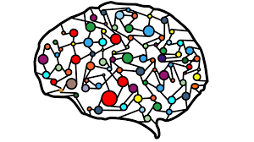
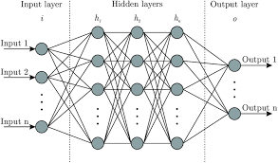
Artificial Neural Networks
A computer program inspired by certain presumed organizational principles of a real neural network (such as your brain)
A series of algorithms that endeavors to recognize underlying relationships in a set of data through a process that mimics the way the human brain operates.

Slide 21
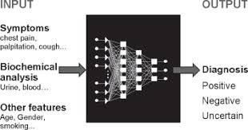
Examples of Artificial Neural Networks
Modular Neural Networks.
Feedforward Neural Network – Artificial Neuron.
Radial basis function Neural Network.
Kohonen Self Organizing Neural Network.
Recurrent Neural Network(RNN)
Convolutional Neural Network.
Long / Short Term Memory.

Slide 22
Learning Outcomes for the Lecture
At the end of this lecture you will be able to:
Understand the term Artificial Intelligence
Explain the concept of expert systems
Understand the importance of machine learning
Explain the frontiers of Artificial Intelligence
Discuss the impacts of Artificial Intelligence

Slide 23
Frontiers of Artificial Intelligence
AI Research Area and Development:
Robotics
Computer Vision
Speech Recognition
Natural Language Processing (NLP)

Slide 24

Robotics
Involves building machines that are capable of performing physical tasks
ElliQ: Can be integrated with various messaging and social media platforms, enabling users to send and receive texts and pictures without fussing with a cellphone
Can hold conversations with patients
Remind patients to take their medications
Lead patients in light physical activities to improve physical and mental health

Slide 25
Computer Vision
Primarily focused on equipping computers with the ability to “see,” in the sense of interpreting visual images
AmazonGo Stores: cameras are used to let employees know when something was taken off the shelves. It can also identify returned items or removed items from a shopping cart
Facebook: Uses facial recognition (“DeepFace”) when automatically tagging photos that are posted to your profile

Slide 26
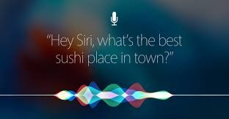
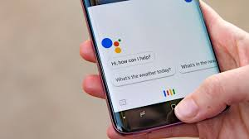

Speech Recognition
The process of converting speech signal into digital data
Siri/Google Assistant/Galaxy: You can commend for the system to do perform tasks or ask questions about movies, sports, and restaurants. Each displays a beautifully formatted response and speaks in a calm voice

Slide 27
Natural Language Processing (NLP)
Deals with the interaction between computers and humans using the natural language
Predictive Text: An input technology that facilitates typing on a mobile device by suggesting words the end user may wish to insert in a text field
Google Search (RankBrain): All of our Google search queries are being run through RankBrain
Learnt which search results we like
Find pages that might not have the exact words we searched for but that we would find interesting and relevant to what we are looking for

Slide 28
Learning Outcomes for the Lecture
At the end of this lecture you will be able to:
Understand the term Artificial Intelligence
Explain the concept of expert systems
Understand the importance of machine learning
Explain the frontiers of Artificial Intelligence
Discuss the impacts of Artificial Intelligence

Slide 29
Impacts of AI on Human Labor
Are robots going to take away our jobs?
What new tasks will AI systems automate?
Which jobs are most and least at risk?
How will AI affect blue-collar workers?
How will AI affect white-collar professions?

Slide 30
Summary
Artificial Intelligence
Expert Systems
Machine Learning and Neural Network
AI Frontiers
Robotics
Computer Vision
Voice Recognition
NLP
Impacts of AI on Human Labor

Slide 31
Questions and Answer
Q & A

Slide 32

Next Lecture
Innovation through Analytics

